Slide 1
Agrégation spatiotemporelle pour la visualisation de traces d’exécution
Damien Dosimont
Advisor: Guillaume Huard – Co-advisor: Jean-Marc Vincent

Slide 2



In a few words…
Analysis of large execution traces, provided by
multimedia/embedded applications
parallel/scientific computing applications
Design of a method based on
visualization
data aggregation
interaction
following a top down approach
Design and implementation in an analysis software

Slide 3
Summary

Slide 4

Context

Slide 5



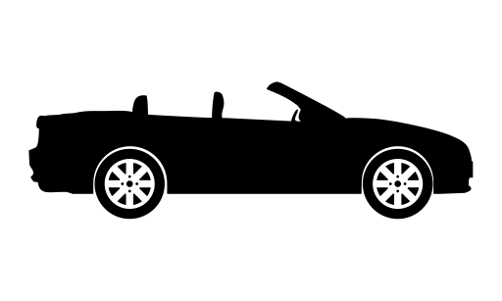





Embedded systems are everywhere!
SoC-Trace

Slide 6





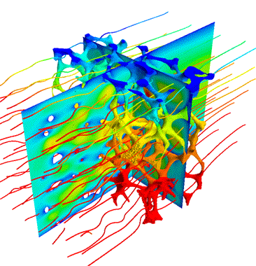








Large scale parallel and distributed systems too

Slide 7

Main thread

Slide 8

May the quality of service be with you

Slide 9

How to analyze this application?
?

Slide 10
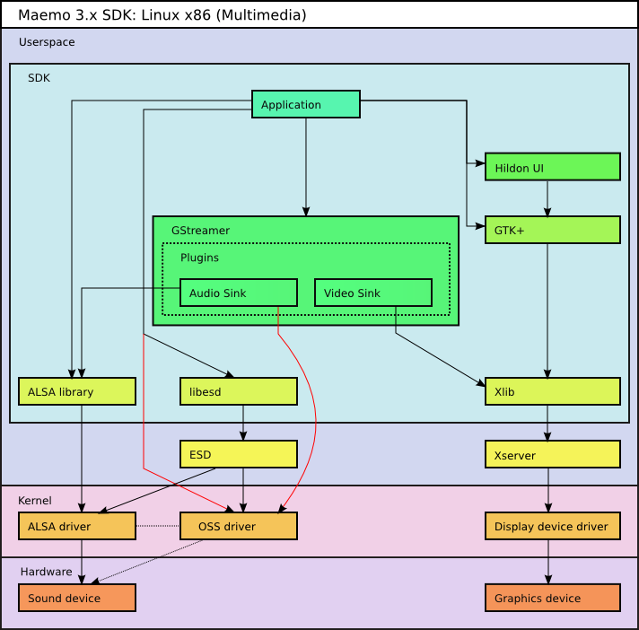
Complexity of multimedia applications

Slide 11



How to debug our application?
Classic step-by-step debugger (ex: GDB) not compatible with streaming/real time aspect
Trace Analysis
Tracing: collect information about the execution and save them in a file
Analyze the content post-mortem
Visualization techniques

Slide 12






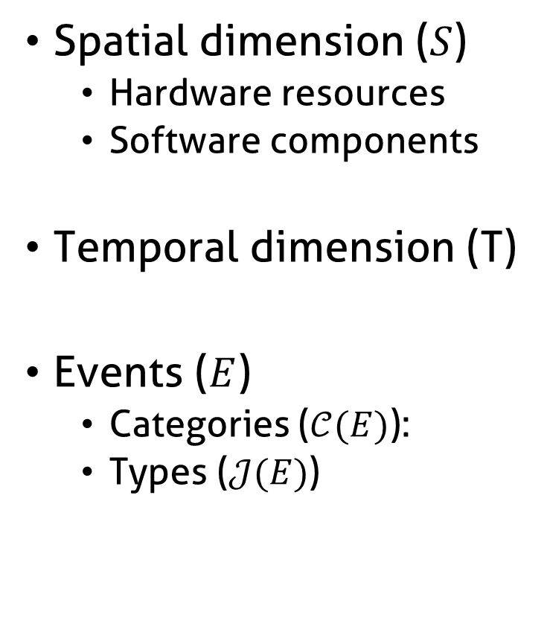
Information contained in traces
Spatial dimension ($S$)
Hardware resources
Software components
Temporal dimension (T)
Events ($E$)
Categories ($𝒞(E)$):
Types ($𝒥(E)$)

Slide 13
Visualize structure and temporal behavior
Space-time diagram inspired by Gantt Chart
Exemple of a sequential pattern with context switches
Exemple of a parallel execution with communications

Slide 14
How we imagine analyzing the application

Slide 15
How we imagine analyzing the application

Slide 16
How we imagine analyzing the application
Function green(){
…
}
Function red(){
…
}
Function purple(){
…
}

Slide 17
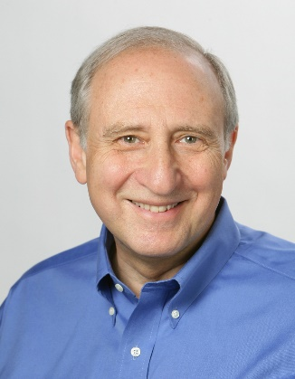




Shneiderman’s mantra
Overview first,
Zoom
and
Filter,
then
Details-on-demand
}

Slide 18





What about scalability?

Slide 19
Visualization support
+
=
≈
6 graphical objects
4 available pixels
Fitting graphical
objects with pixels
Final representation:
-some objects are lost
-proportions are not kept

Slide 20

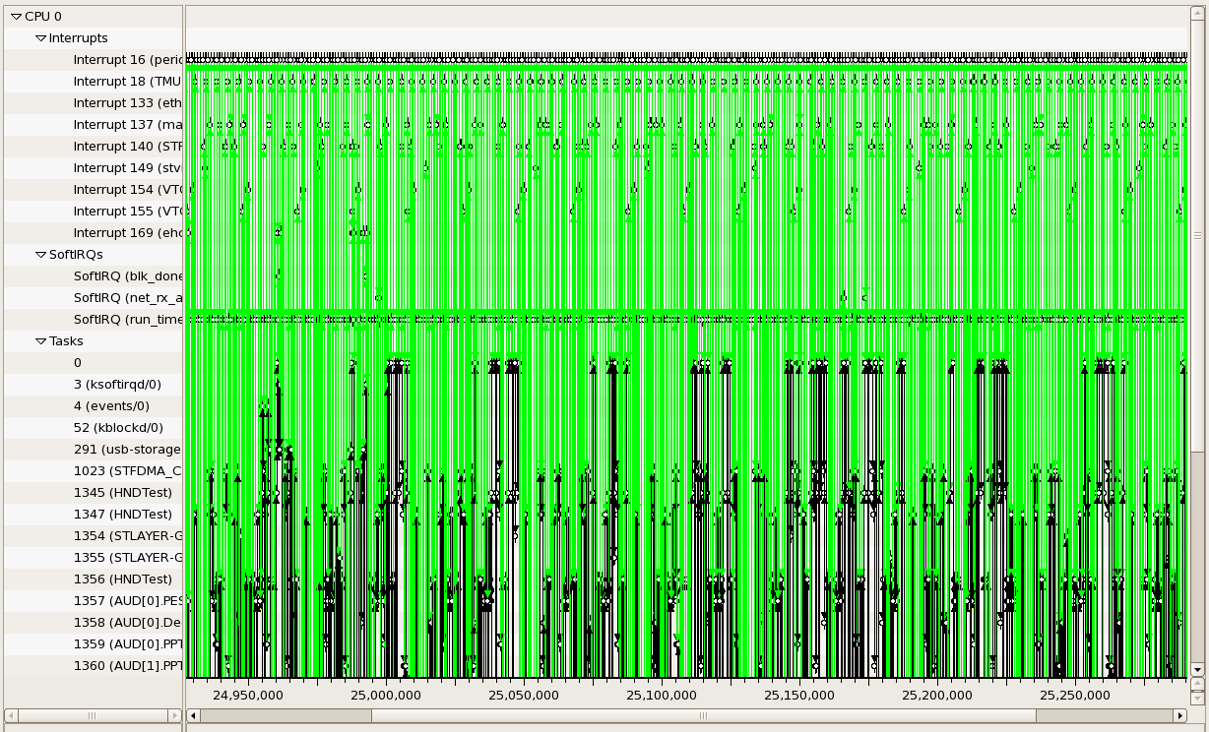
Visualization support

Slide 21
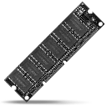


Performance
Memory Limitations
Hardware performance
Algorithmic complexity
Libraries, components, languages, etc.

Slide 22

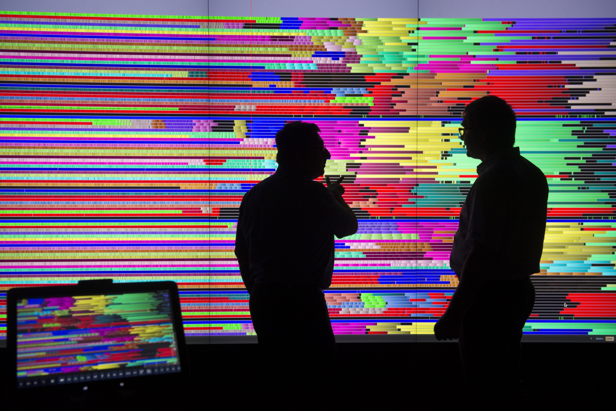
User

Slide 23

Shneiderman’s mantra
Overview first,
Zoom
and
Filter,
then
Details-on-demand
}

Slide 24

Proposal

Slide 25
Fulfill Shneiderman’s with Ocelotl

Slide 26
Overview
Temporal
Spatiotemporal

Slide 27

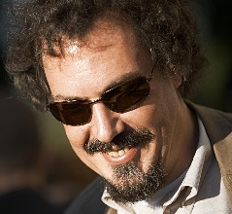
Elmqvist & Fekete’s criteria
Entity Budget
Visual Summary
Visual Simplicity
Discriminability
Fidelity
Interpretability

Slide 28
Overview: contributions
Data aggregation following Lamarche-Perrin’s method
Temporal aggregation: significant extension to trace analysis
Spatiotemporal aggregation: new algorithm
Visualization techniques
Punctual visual aggregation

Slide 29
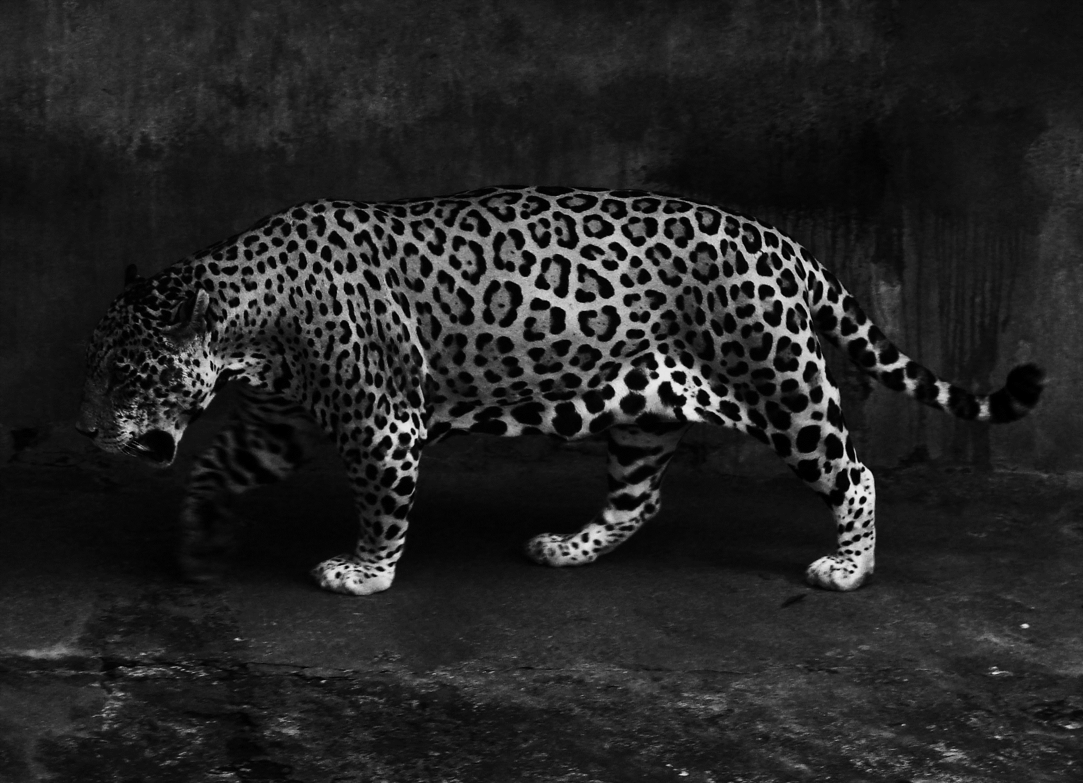
Ocelotl Analysis Tool
Overviews
Interaction mechanisms
Performance ensuring for large traces
Modularity

Slide 30
Lamarche-Perrin’s Method

Slide 31



Multi agent system analysis
Analytic approach
Complex
System
Microscopic
Obervation
Microscopic
Representation
Analyst
Complexity
Quantity of data

Slide 32


Multi agent system analysis
Systemic approach
Microscopic
Representation
Abstraction
Complex
System
Microscopic
Obervation
Macroscopic
Representation
Analyst

Slide 33

Lamarche-Perrin’s method
Microscopic
Representation
Abstraction
Complex
System
Microscopic
Obervation
Macroscopic
Representation
Method based on Partition+Aggregation
Analyst

Slide 34

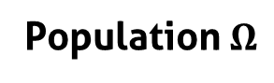
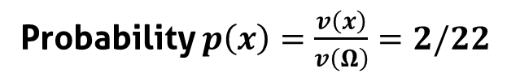
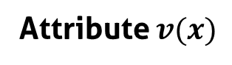
Population, individuals, attributes
Population $Ω$
5
1
Individuals $x$
9
1
4
2
Attribute $v(x)$
Probability $p\left(x\right)=\frac{v\left(x\right)}{v\left(Ω\right)}=2/22$

Slide 35
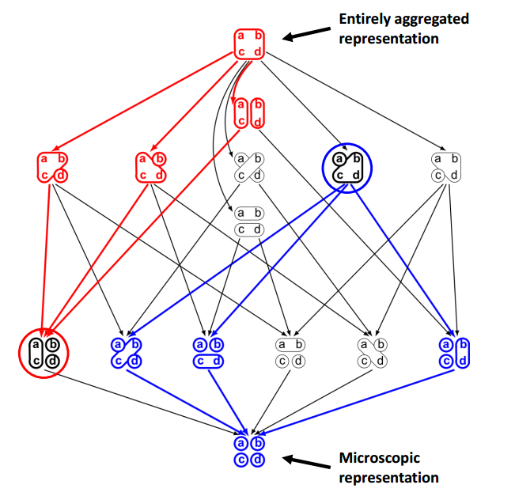
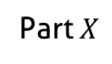
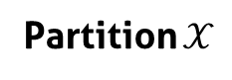
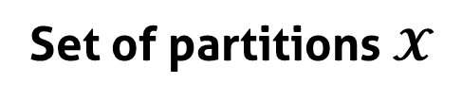
Partition the population
Set of partitions $𝓧$
Part $X$
5
1
9
1
Partial order
2
4
Partition $𝒳$

Slide 36
From the partition to the interpretation
5
5
1
15
5
9
5
1
1
1
2
6
3
4
3
Partition
Aggregation
(sum)
Redistribution
(uniform)
Visualization

Slide 37
How to choose the « good » partitions?
?

Slide 38
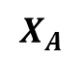
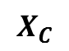
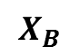
Best Partition problem
Find the partitions that maximize (minimize) quality measures
Quality measures are monotone, decomposable, and may be additive
$$X_{A}$$
$$Quality(𝒳) = Quality(X_{A}) + Quality(X_{B}) + Quality(X_{C})$$
5
1
9
1
$$X_{B}$$
2
4
$$X_{C}$$

Slide 39
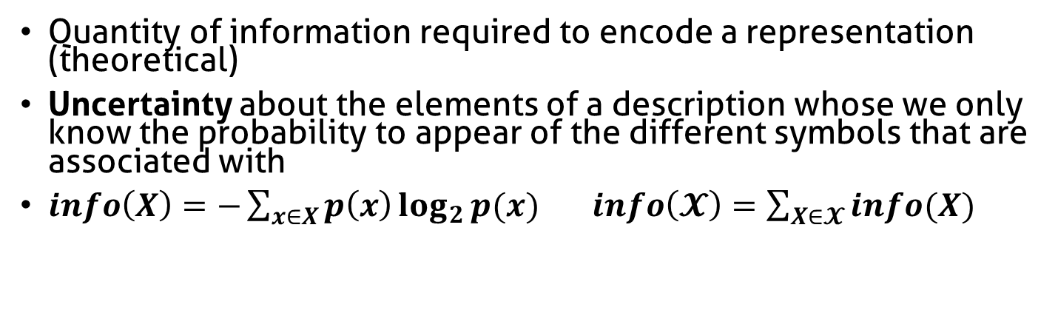
Complexity
Quantity of information required to encode a representation (theoretical)
Uncertainty about the elements of a description whose we only know the probability to appear of the different symbols that are associated with
$info\left(X\right)=−\sum_{x∈X}{p\left(x\right)\log_{2}{p(x)}}$ $info\left(𝓧\right)=\sum_{X∈𝓧}{info(X)}$
Complexity
5
5
5
1
1
1
1
1
1
9
9
9
2
2
2
4
4
4
Number of elements (aggregates)

Slide 40
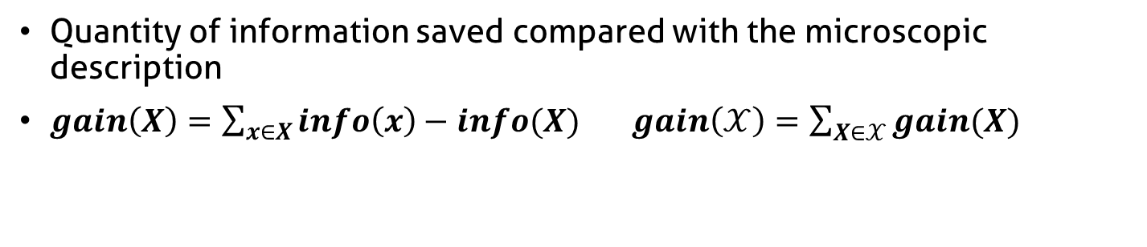
Complexity reduction
Quantity of information saved compared with the microscopic description
$gain\left(X\right)=\sum_{x∈X}{info\left(x\right)−info(X)}$ $gain\left(𝒳\right)=\sum_{X∈𝒳}{gain(X)}$
Complexity reduction
5
5
5
1
1
1
1
1
1
9
9
9
2
2
2
4
4
4
Number of elements (aggregates)

Slide 41
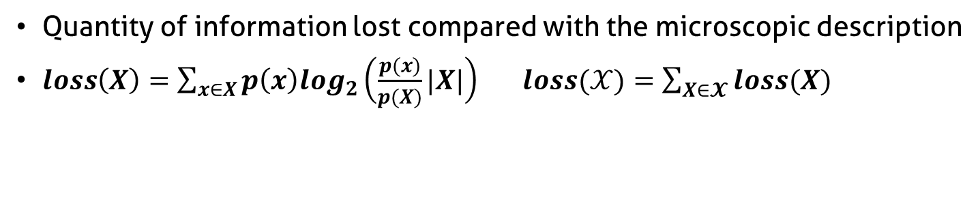
Information Loss
Quantity of information lost compared with the microscopic description
$loss\left(X\right)=\sum_{x∈X}{p\left(x\right)log_{2}\left(\frac{p(x)}{p(X)}|X|\right)}$ $loss(𝒳)=\sum_{X∈𝓧}{loss(X)}$
5
High
Information Loss
4
1
1
4
4
9
4
4
4
4
4
5
Low
Information Loss
4
4
4
4
4
4
4
4
4
3
4

Slide 42
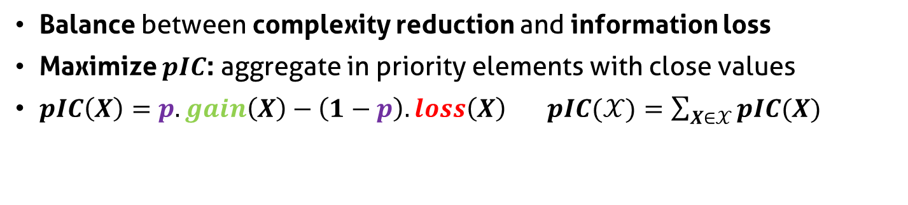
Parametrized Information Criterion
Balance between complexity reduction and information loss
Maximize $pIC$: aggregate in priority elements with close values
$pIC\left(X\right)=p.gain\left(X\right)−\left(1−p\right).loss\left(X\right)$ $pIC(𝒳)=\sum_{X∈𝒳}{pIC(X)}$
Parameter p
Complexity reduction
5
5
5
1
1
1
1
1
1
9
9
9
2
2
2
4
4
4
Information loss

Slide 43
Constrain the set of partitions
Reduce set of partition size
Decrease algorithmic complexity
Bring coherence with syntaxic and semantic characteristics of the system

Slide 44
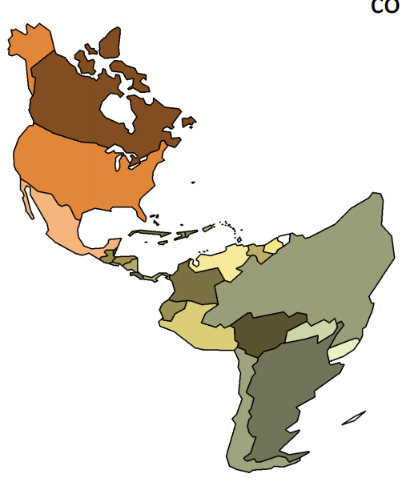
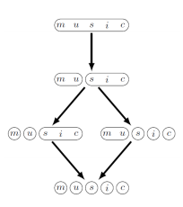

Ex: Hierarchical aggregation
Spatial analysis
Admissible partitions

Slide 45
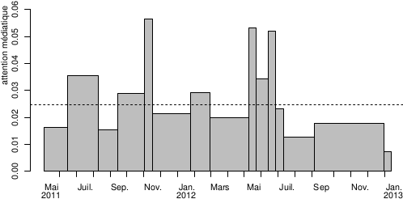
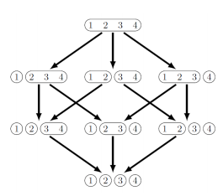
Ex: Ordered set aggregation
Temporal analysis
Admissible partitions

Slide 46
How to build a polynomial algorithm?
Dynamic programming (divide and conquer)
Covering relation (lattice)
Quality measure additivity

Slide 47

Temporal Analysis

Slide 48
Interest of Temporal Analysis

Slide 49







How to adapt LP method to trace analysis?
?
?
Trace =
Nanoscopic
Model
Microscopic
Model
Qualities
Partition
Abstraction
Visualization

Slide 50
Build a microscopic model from the trace
?
?
Trace =
Nanoscopic
Model
Microscopic
Model
Qualities
Partition
Abstraction
Visualization

Slide 51
Build a microscopic model from the trace
Trace =
Nanoscopic
Model
Discretization
Microscopic
Model
Time continuous
Space discrete
Event types discrete
Time discrete
Space discrete
Event types discrete

Slide 52
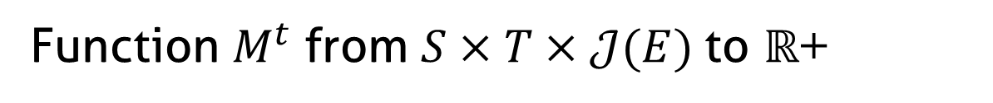
Microscopic model structure
Function $M^{t}$ from $S×T×𝒥(E)$to $ℝ$+
J5
J4
J3
Event types
J2
J1
s1
Space
s2
s3
t1
t2
t3
t4
t5
Time (discrete)

Slide 53
Fill the microscopic model
Time (continuous)
Sum of state durations
s1
s2
Time slice
Space
s3
d1 + d2 + p1*d3
s1
d1+d2+p1*d3
s2
Space
s3
t1
t2
t3
t4
t5
Time (discrete)

Slide 54
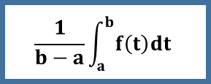
Fill the microscopic model
Event occurrences
Average state duration
Variable mean
Time slice
Time slice
Time slice
1 + 1 + 1
d1 + d2 + p1*d3
a
b
3
(d1+d2+p1*d3)/3
$$\frac{1}{b−a}\int_{a}^{b}{f\left(t\right)dt}$$

Slide 55
Aggregate the microscopic model
Original algorithm:
scalar values
t1
t2
t3
t4
t5
Time (discrete)
Objective:
multidimensional
values
t1
t2
t3
t4
t5
Time (discrete)

Slide 56
Adapt the quality computation
?
Trace =
Nanoscopic
Model
Microscopic
Model
Qualities
Partition
Abstraction
Visualization

Slide 57
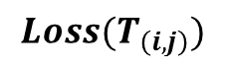
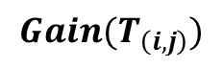
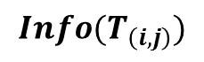
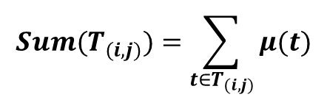
Quality computation of monodimensional values
Monodimensional microscopic model
Intermediate measures
$$Sum(T_{(i,j)})=\sum_{{t∈T}_{(i,j)}}{μ(t)}$$
Time (discrete)
Data structure of time intervals T(i,j)
$$Info(T_{\left(i,j\right)})$$
Quality measures
i
$$Gain(T_{\left(i,j\right)})$$
$$Loss(T_{\left(i,j\right)})$$
j

Slide 58
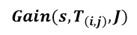
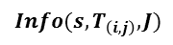
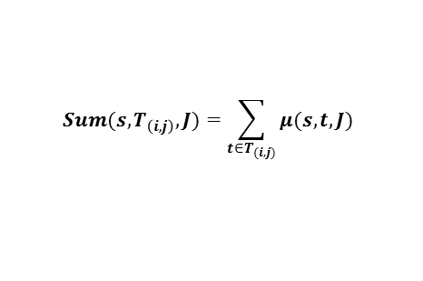
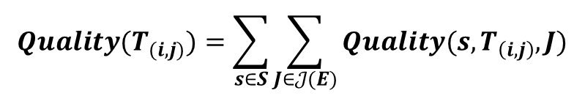
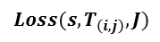
Quality computation of multidimensional values
Intermediate measures
$$Sum(s,T_{\left(i,j\right)},J)=\sum_{{t∈T}_{(i,j)}}{μ(s,t,J)}$$
Jr
Jb
s1
$$Info({s,T}_{\left(i,j\right)},J)$$
Quality measures
s2
$$Gain(s,T_{\left(i,j\right)},J)$$
$$Loss(s,T_{\left(i,j\right)},J)$$
=
+
+
+
$$Quality(T_{(i,j)})=\sum_{s∈S}{\sum_{J∈𝒥(E)}{Quality(s,T_{\left(i,j\right)},J)}}$$

Slide 59
Best cut computation
?
Trace =
Nanoscopic
Model
Microscopic
Model
Qualities
Partition
Abstraction
Visualization

Slide 60
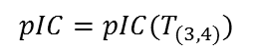
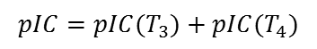
Best cut computation
Compute, compare, and select pIC for time intervals
pIC=p*gain-(1-p)*loss
User provides p
Already
computed
Ex: 4 time slices
$$pIC=pIC(T_{3})+pIC(T_{4})$$
Possible cuts: Cut[i]
i=4
Cut[4]=4
$$pIC=pIC(T_{(3,4)})$$
i=3
or
Cut[3]=3 or 4
i=2
or
or
Cut[2]=2, 3 or 4
or
or
i=1
Cut[1]=1, 2, 3 or 4
or

Slide 61

Rebuild the best partition
Example
Cut[1]?
Cut[1]=2
Cut[2+1]?
Cut[3]=3
Cut[3+1]?
Cut[4]=4
Best Partition

Slide 62
Interpret the aggregation result
?
Trace =
Nanoscopic
Model
Microscopic
Model
Qualities
Partition
Abstraction
Visualization

Slide 63
Aggregate and redistribute the values
Microscopic model
Partition
?
Aggregation (sum)
!
Uniform redistribution

Slide 64
Visualize the trace abstraction
?
Trace =
Nanoscopic
Model
Microscopic
Model
Qualities
Partition
Abstraction
Visualization

Slide 65
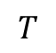
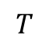
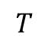
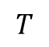
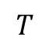
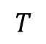
Visualize the trace abstraction
Bar chart
$$T$$
Colored
partition
$$T$$
$$T$$
Stacked bar
chart
$$T$$
$$T$$
Mode
$$T$$
Spatial aggregation
Aggregation of event types

Slide 66
Stacked bar chart visual aggregation
minimal height
blue + orange event type
total height < minimal height
blue event type
height < minimal height
blue + orange event type
individual height < minimal height
total height > minimal height
Decrease available height

Slide 67
Example of analyses

Slide 68
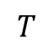
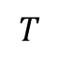
Main thread
Parameter p increasing
$$T$$
$$T$$

Slide 69




TS Record use case
IP buffers
Memory
Hard drive
IP packets
sys_write()
flush-8:0
every
100 ms
Disk cache
every
5000 ms
230 KB

Slide 70
TS Record analysis

Slide 71
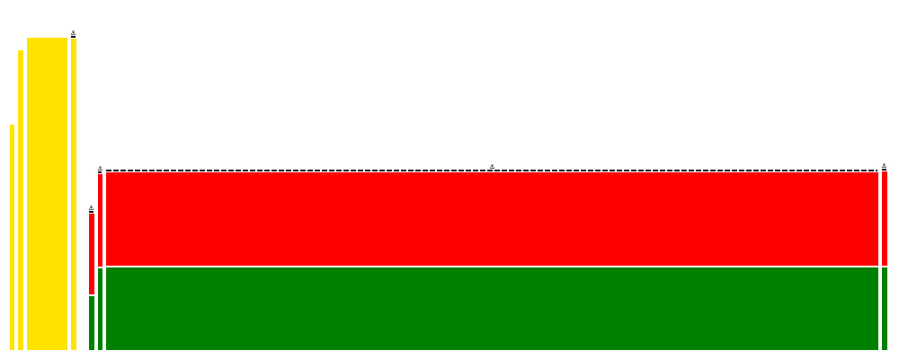


Conjugate Gradient running on G5K

Slide 72

We need some space!

Slide 73

Spatiotemporal Analysis
+

Slide 74

Interest of spatiotemporal analysis

Slide 75




Hardware/software hierarchy
Hardware components
Site
Clusters
Nodes
Cores
Threads
Software components

Slide 76
Build a microscopic model from the trace
Trace =
Nanoscopic
Model
Discretization
+ Hierarchization
Microscopic
Model
Time continuous
Space flat
Event types discrete
Time discrete
Space hierarchized
Event types discrete

Slide 77

Microscopic model structure
Function $M^{st}$ from $S×T×𝒥(E)$to $ℝ$+
Event types
J3
J2
J1
s1
s2
Space
s3
s4
s5
t1
t2
t3
t4
t5
Time (discrete)

Slide 78

Hierarchize the spatial dimension
Event types
J3
J2
J1
s1
Sa
s2
Hierarchy $ℋ(S)$
s3
S
s4
Sb
s5
t1
t2
t3
t4
t5
Time (discrete)

Slide 79

Aggregate the microscopic model
s1
Sa
s2
Hierarchy $ℋ(S)$
s3
S
s4
Sb
s5
t1
t2
t3
t4
t5
Time (discrete)

Slide 80
Forbidden Aggregates
s1
Sa
s2
Hierarchy $ℋ(S)$
s3
S
s4
Sb
s5
t1
t2
t3
t4
t5
Time (discrete)

Slide 81
Visualize the abstraction

Slide 82
Visual aggregation
Decrease available height

Slide 83
Example of analyses

Slide 84
Lower Upper Gauss Siedel on G5K

Slide 85

Implementation: Ocelotl Analysis Tool

Slide 86

Presentation

Slide 87
Ocelotl Architecture

Slide 88


Framesoc

Slide 89
Shneiderman’s mantra: Overview

Slide 90
Shneiderman’s mantra: Zoom

Slide 91
Shneiderman’s mantra: Filter

Slide 92

Shneiderman’s mantra: Details on demand

Slide 93

Shneiderman’s mantra: Details on demand

Slide 94

Shneiderman’s mantra: Details on demand

Slide 95



Performance
! Query optimization
Microscopic
model
Qualities
Quality curves
Abstraction
Trace (DB)
Visualization
! Microscopic Model
Cache

Slide 96
Query Optimization

Slide 97
Cache Performance

Slide 98
Temporal Aggregation

Slide 99
Spatiotemporal Aggregation

Slide 100
In practical…
Real traces:
Up to 12 GB (218 million of events)
Temporal: ~1500 resources
Spatiotemporal: ~700 resources
Synthetic traces:
Up to 68 GB (2 billion of events)
Temporal: ~ 100 000 resources, 10 event types, 100 time slices
Spatiotemporal: ~10 000 resources, 10 event types, 30 time slices

Slide 101
Conclusion

Slide 102
Publications
International Conferences
A Spatiotemporal Data Aggregation Technique for Performance Analysis of Large-scale Execution Traces. Damien Dosimont, Robin Lamarche-Perrin, Lucas Mello Schorr, Guillaume Huard, Jean-Marc Vincent, IEEE Cluster 2014, pages 149-157, Madrid, September 2014.
Efficient Analysis Methodology For Huge Application Traces. Damien Dosimont, Generoso Pagano, Guillaume Huard, Vania Marangozova-Martin, Jean-Marc Vincent, 2014 International Conference on High Performance Computing & Simulation, pages 951-958, Bologna, June 2014.
Trace Management and Analysis for Embedded Systems. Generoso Pagano, Damien Dosimont, Guillaume Huard, Vania Marangozova-Martin, Jean-Marc Vincent, 2013 IEEE 7th International Symposium on Embedded Multicore Socs (MCSoC), pages 119-122, Tokyo, September 2013.
Workshops
Ocelotl: Large Trace Overviews Based on Multidimensional Data Aggregation. Damien Dosimont, Youenn Corre, Lucas Mello Schnorr, Guillaume Huard, Jean-Marc Vincent, 8th International Parallel Tools Workshop (IPTW’14), Stuttgart, October 2014.
Agrégation temporelle pour l’analyse de traces volumineuses. Damien Dosimont, Guillaume Huard, Jean-Marc Vincent, 10ème Atelier en Evaluation de Performances, Sophia Antipolis, June 2014.
La visualisation de traces, support à l’analyse, déverminage et optimisation d’applications de calcul haute performance. Damien Dosimont, Guillaume Huard, Jean-Marc Vincent, Atelier Visualisation d’informations, interaction et fouille de données (VIF) de la 13e Conférence Francophone sur l’Extraction et la Gestion des Connaissances (EGC’2013), pages 55-66, Toulouse, January 2013.

Slide 103



Thanks

Slide 104
Backup

Slide 105
Main thread: a recording application
Streaming
Record
TV program
Set-top box
Hard drive
TS Record use case

Slide 106
How to adapt LP method to spatiotemporal analysis?
?
?
?
?
?
Trace =
Nanoscopic
Model
Microscopic
Model
Qualities
Partition
Abstraction
Visualization

Slide 107
Microscopic model building
?
?
?
?
?
Trace =
Nanoscopic
Model
Microscopic
Model
Qualities
Partition
Abstraction
Visualization

Slide 108
Quality computation
?
?
?
?
Trace =
Nanoscopic
Model
Microscopic
Model
Qualities
Partition
Abstraction
Visualization

Slide 109
Best cut computation
?
?
?
Trace =
Nanoscopic
Model
Microscopic
Model
Qualities
Partition
Abstraction
Visualization

Slide 110





Quality computation
Intermediate measures
Quality measures
$$Sum\left(S_{a},T_{\left(i,j\right)},J\right)=\sum_{s∈S_{a}}{\sum_{{t∈T}_{(i,j)}}{μ(s,t,J)}}$$
$$Gain(S_{a},T_{\left(i,j\right)},J)$$
$$Info({S_{a},T}_{\left(i,j\right)},J)$$
$$Loss(S_{a},T_{\left(i,j\right)},J)$$
$$Quality\left(S_{a},T_{\left(i,j\right)}\right)=\sum_{J∈𝒥(E)}{Quality(S_{a},T_{\left(i,j\right)},J)}$$
s1
=
+
S
s2
=
+
=
+

Slide 111
Aggregation algorithm
Best cut: sequence of spatial and temporal cuts
Aggregation, redistribution: principle similar to temporal algorithm

Slide 112
Scalability and aggregation

Slide 113
Aggregation
General definition
Some properties
Examples

Slide 114
Aggregated representations
Data, visual, hybrid aggregations

Slide 115
What is a good overview?
Elmqvist and Fekete

Slide 116
Why exisiting methods are not satisfying?
Give some examples

Slide 117
Our approach is different

